Slide 1
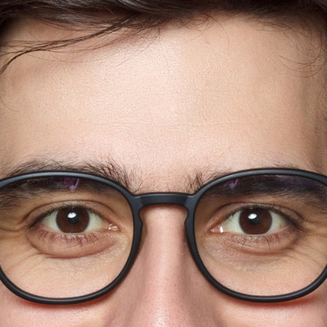
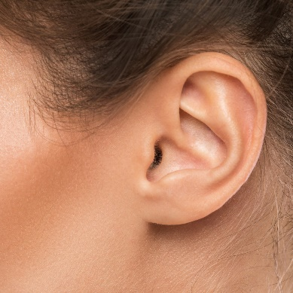
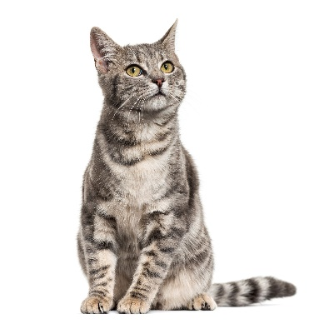
2021 The Life of
a CareCredit PDM
Presented by: Karen Zupko, President
www.karenzupko.com

Slide 2
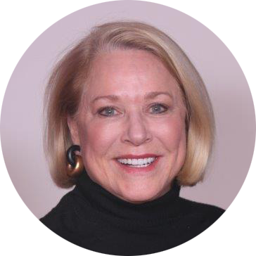
ASAPS Courses
Managing Up and Down and Inside Out Karen Zupko and Judy Kozlicki
106 Successful Principles for Non-Surgical Services: Fast Track Your ROI Marie Olesen* and Karen Zupko*
305 Relationship Marketing: What It Means and How to Put It in Action Karen Zupko*
NEW 405 Staff: Your Biggest Expense or Your Biggest Asset? Karen Zupko
Karen Zupko, President
Educating and advising board certified plastic surgeons about the business side of practice has been Karen's passion for more than two decades. She is internationally known as an entertaining, energetic and informative speaker, and has been called a “shot of B12 to the brain!” Her keen sense of humor keeps people’s attention.

Slide 3
Intro to the
Cosmetic Market Who is your Client?
Board Certified Plastic Surgeons
Facial Plastic Surgeons
Ocuplastic Surgeons
Dermatologists + Derm Surgeons
“Cosmetic Surgeons”

Slide 4
Medical Spa Definitions
The American Med Spa Association defines a medical spa as a hybrid between an aesthetic medical center and a “day spa” with four core elements:
the provision of non-invasive (i.e., non-surgical) aesthetic medical services;
under the general supervision of a licensed physician;
performed by trained, experienced and qualified practitioners;
with onsite supervision by a licensed healthcare professional.

Slide 5
But not one set of regulations….
Notes:
Wild west – wide variations state to state – extreme caution is need
Medical Boards, Boards of Registered Nursing and Boards of Cosmetology focus on Medspas
Growing number of undercover investigations, tasks forces, escalation of patient, employee complaints
Demonstrated public interest in safety risks and illegal operations of healthcare facilities

Slide 6
Plastic Surgeons
Facial Procedures
Hair Restoration
Reconstructive Surgery
HDHP
Non-Surgical Services
Official Med Spa
ASC
Breast + Body Elective

Slide 7
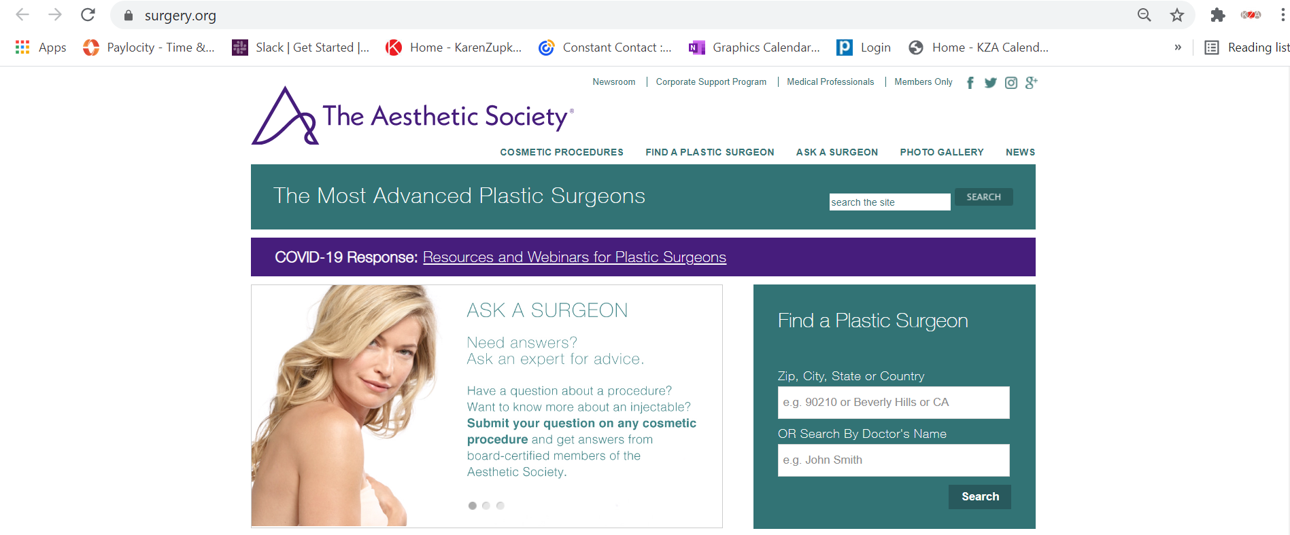
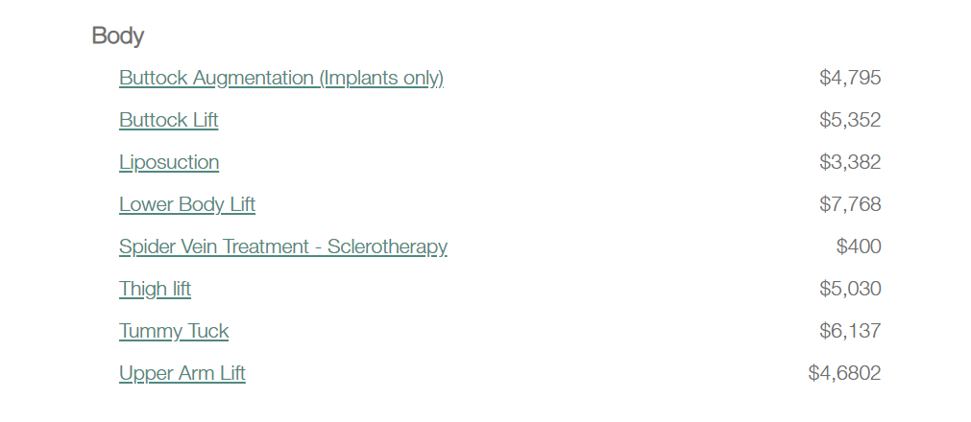
Where to Learn More?

Slide 9
2020 ASAPS Plastic Surgeon Fees: Surgical

Slide 10
2020 ASAPS Plastic Surgeon Fees: Surgical

Slide 11
2020 ASAPS Quick Facts And Highlights

Slide 12
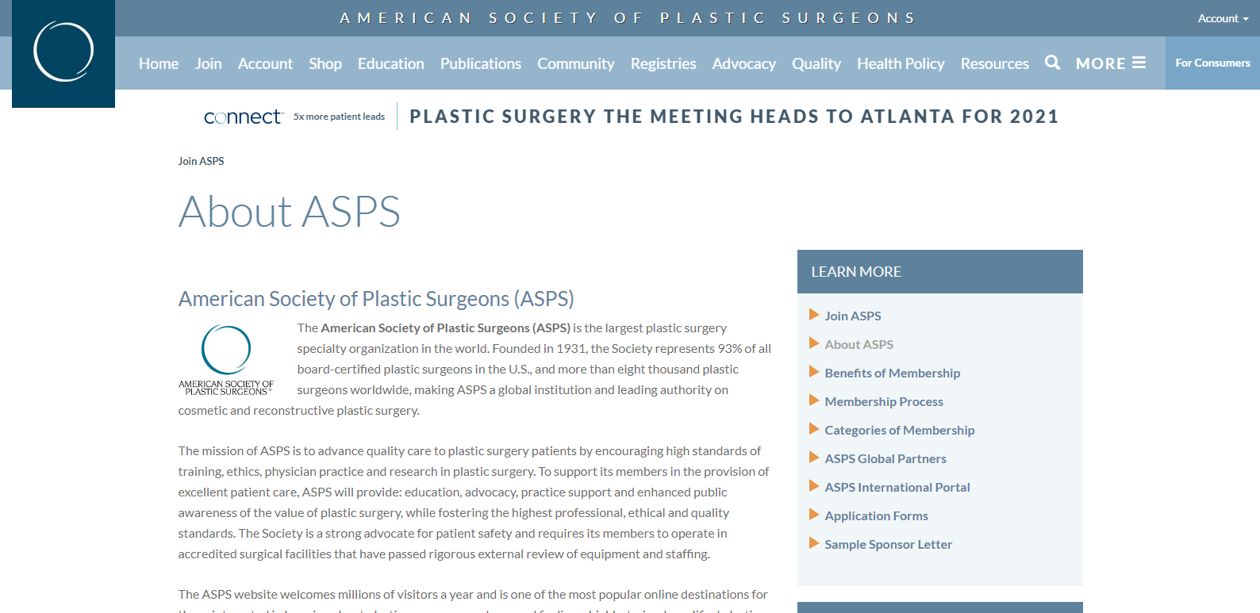

Slide 13
Still, the numbers show we’ve not lost focus on the face, with three of the top five procedures focusing on the above-the-neck procedures:
Nose reshaping (352,555 procedures)
Eyelid surgery (352,112 procedures)
Facelift (234,374 procedures)
Liposuction (211,067 procedures)
Breast augmentation (193,073 procedures)
ASPS 2020 DATA

Slide 14
Not surprisingly, the most sought-after spots still belong to nonsurgical treatments—with more than 4 million injectable procedures being performed last year. “Despite the focus on the face, minimally invasive procedures decreased slightly more than surgical procedures in 2020, dropping for the first time in four years,” says Ventura County, ca plastic surgeon Lynn Jeffers, MD, past-president of ASPS.
ASPS 2020 DATA

Slide 15
“We attribute this mostly to stay-at-home orders with patients having to miss their regularly scheduled appointments and potentially in part due to them looking for enhanced results after having to hold off on some of their maintenance procedures. Despite this slight dip, injectables still remained the most sought-after treatments in 2020.”
ASPS 2020 DATA

Slide 16
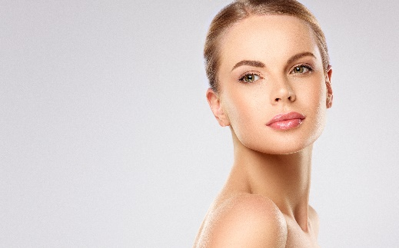
Procedures Where There
Are The Biggest Opportunities
Breast
Body
Face
Augmentation
Mastopexy
Reduction
Reconstruction
HDHP
“Mommy Make-Over”
Breast + ABD
Abdominoplasty
Liposuction
Sculpting
Not so much.

Slide 17
Med spa Patient entry points and progression
6 lines of business
Toxins (highly commoditized, lowest margins)
Fillers (also commoditized, better margins)
Products (pre-set margins by manufacturer)
Aesthetician services (entry point, lower revenue)
Devices (good margins even with consumables)
Lasers (best margins)
Notes:
In order of entry,
Enter through Toxin
Explain slide with examples of each group

Slide 18
Considering ROI for your space
Revenue per hour by room type:
Aesthetician $125-$250
Toxins $700-$870
Injectables $1000 - $2100
Lasers $200 – $2500
Devices $350-$2000
Our facility
1 Consult
1 Aesthetician
3 Toxin/Injectables
3 Laser and devices
Notes:
Laser Hair Removal is $200 and can take a long time based on area and device. Fractional Laser/TRL can be higher profit but also greater risk and more follow up.

Slide 19
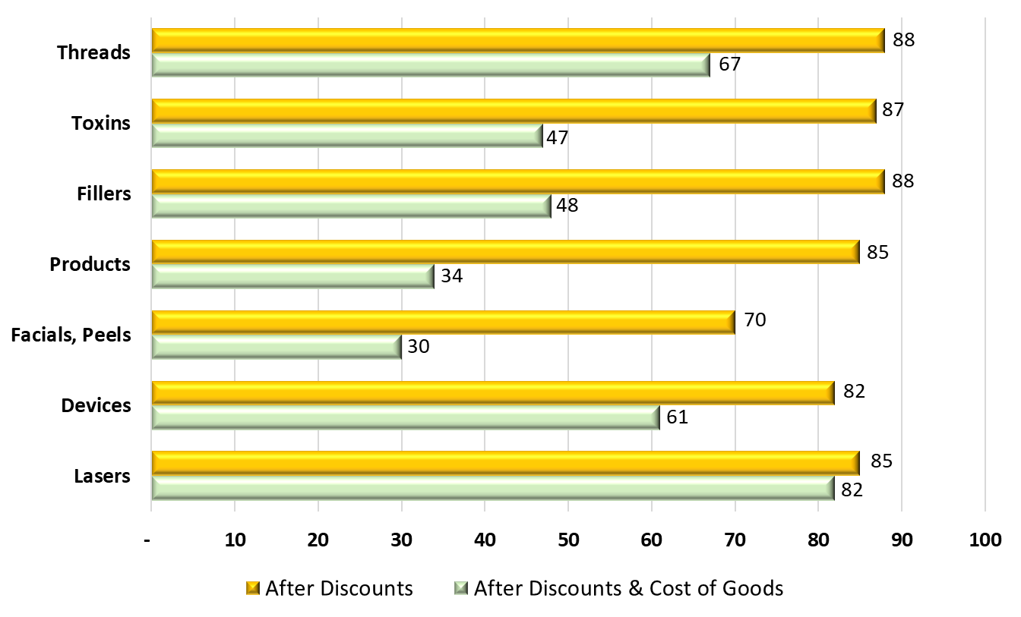
Considering practice mix and profitability*
Includes Surgery Gift Disc.
Notes:
Our margins may not look like your margins
Marie source LJCSC – best margins with lasers, secondarily with devices, even adjusting for consumables.
Practice mix should reflect profitability.
You wouldn’t grow an all Toxin and Filler business, for example.
Intensely Competitive:
Highly Commoditized:
Technology-Driven:
Need to balance low margins with high margin offerings. Best source of patients are your current and former patients

Slide 20
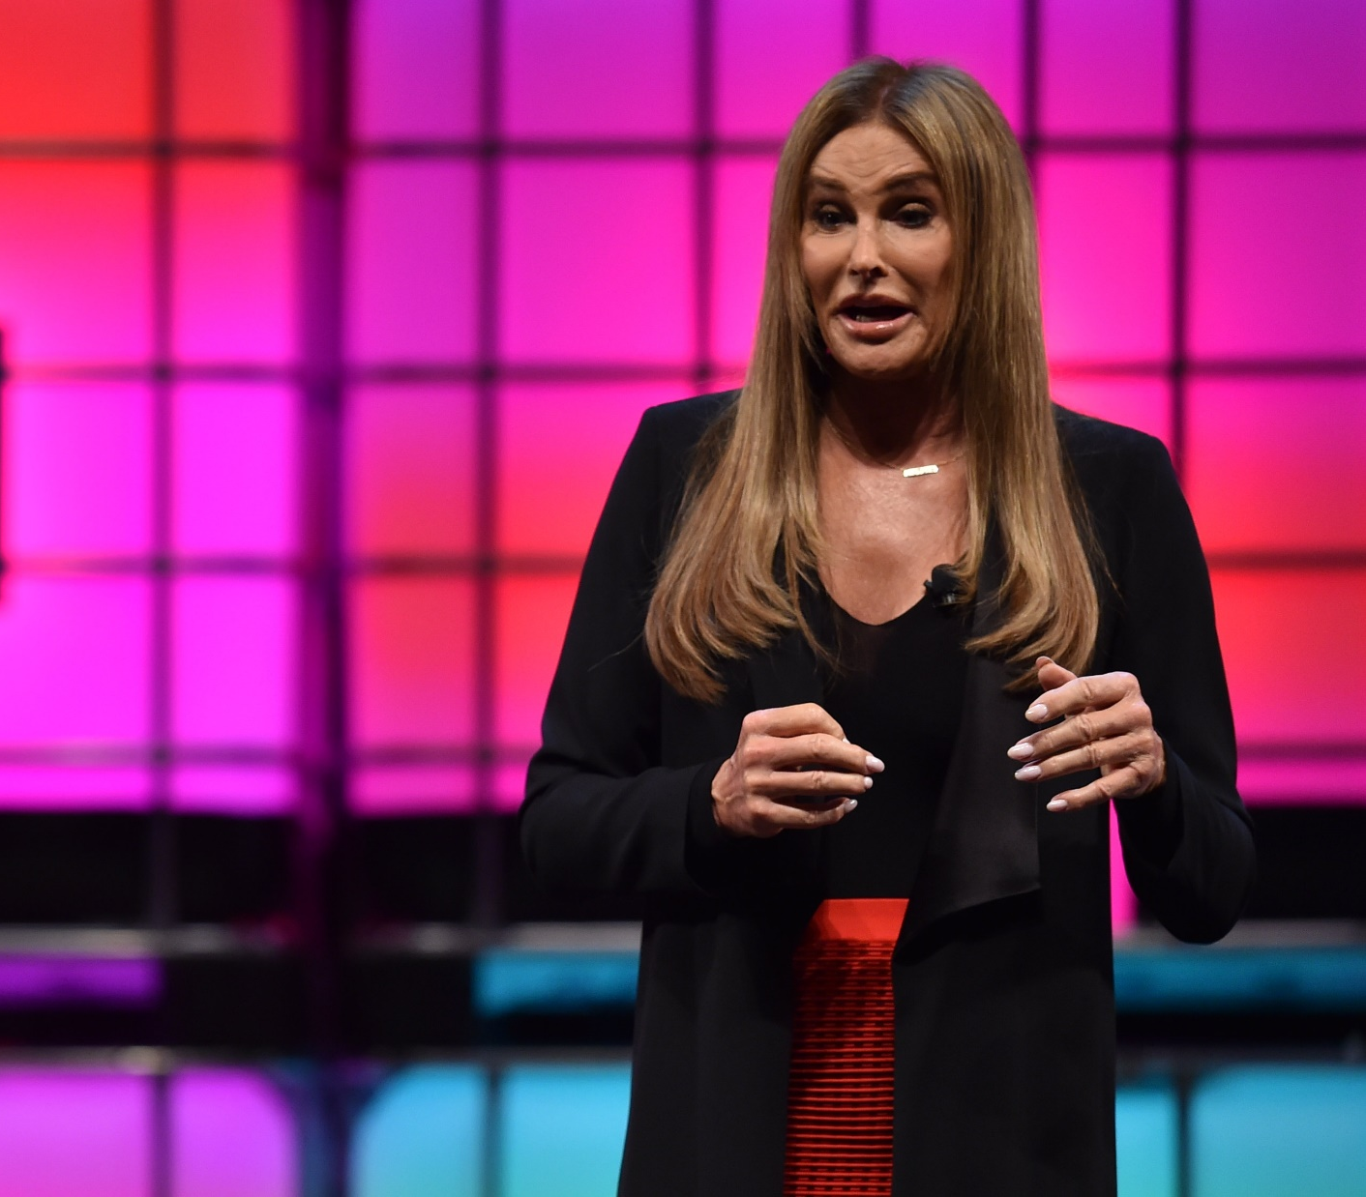
Transgender Surgery
By Web Summit - DF2_7319, CC BY 2.0, https://commons.wikimedia.org/w/index.php?curid=63967204

Slide 21
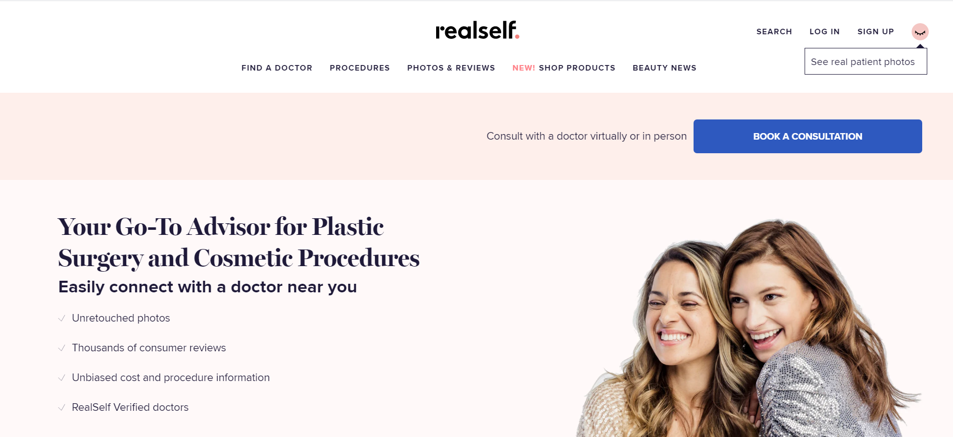

Slide 22
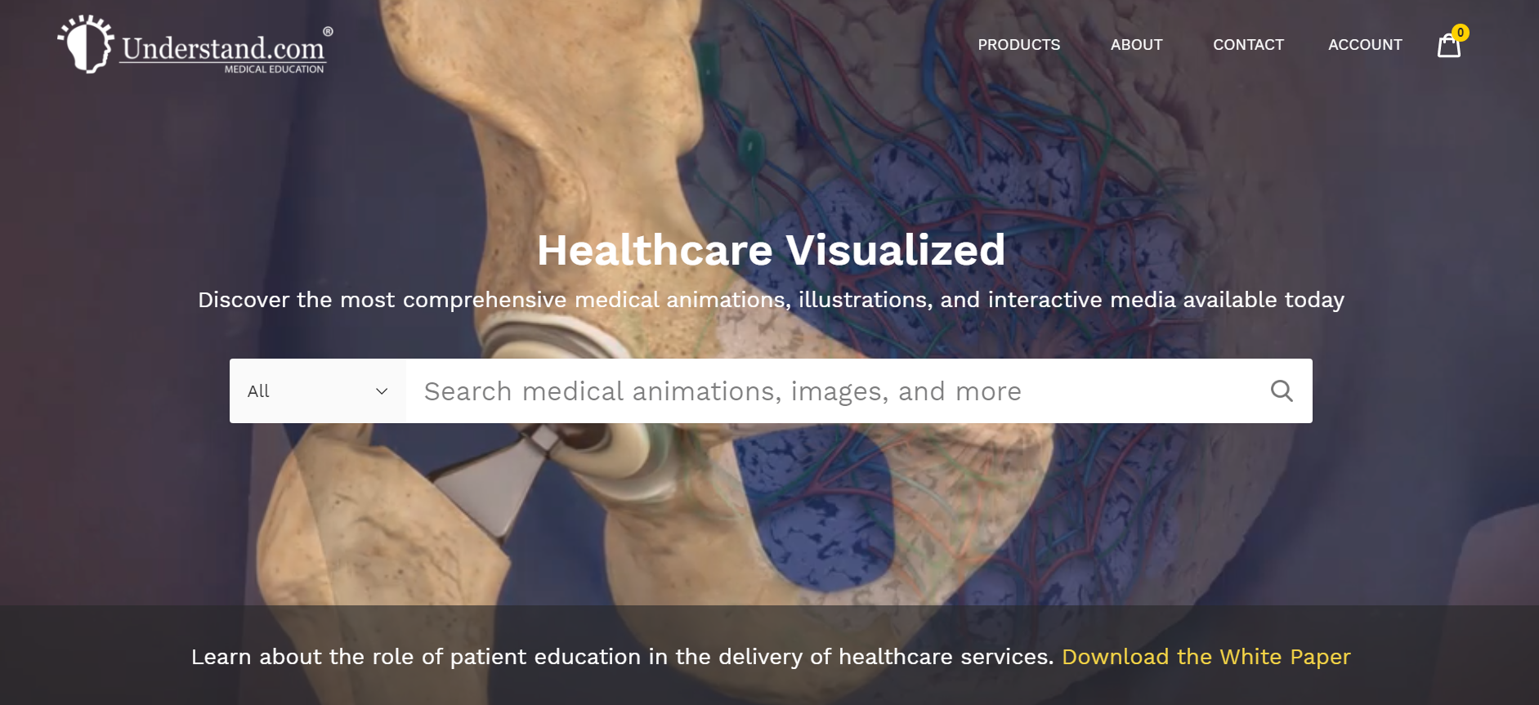

Slide 24
No Interest if paid in full within the 6-, 12-, 18- or 24-Month promotional period
Promotional Period | 6 Month |  | 12 Month |  | 18 Month
Monthly Payment | $867 / mo Suggested |  | $433 / mo Suggested |  | $289 / mo Suggested
Payoff Period | 6 months |  | 12 months |  | 18 months
Amount Financed | $5,200 |  | $5,200 |  | $5,200

Slide 25
Available Credit Reports An Undersold Asset

Slide 26
Staffing in Plastic Surgery Practices
Office Manager
Practice Manager
Practice Administrator
Patient Coordinator
Scheduler

Slide 27
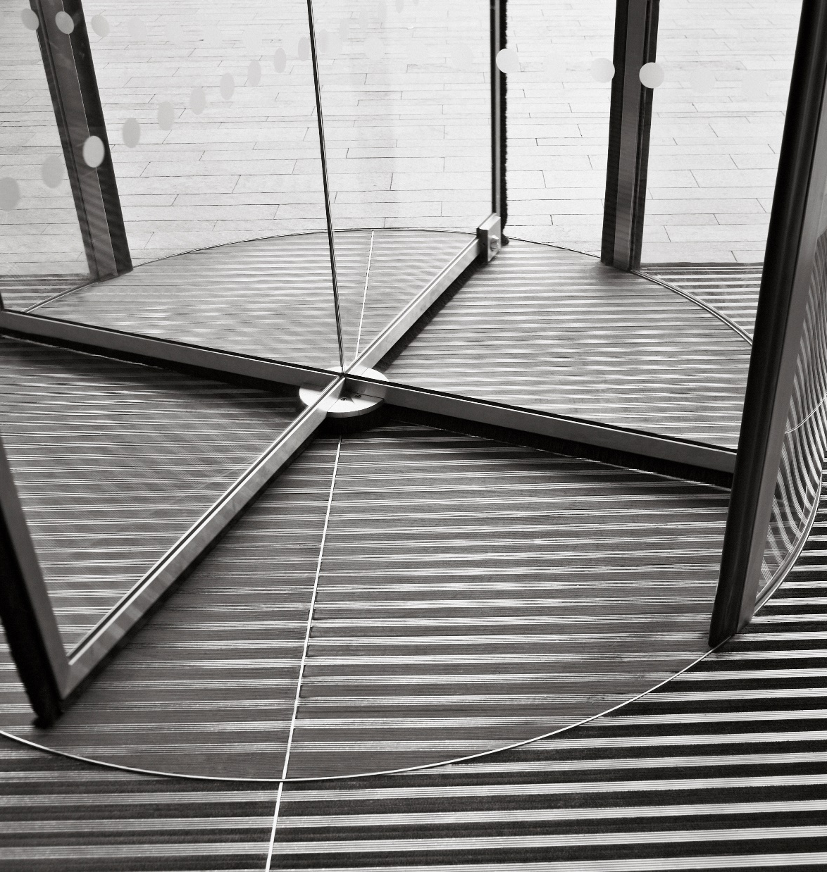
Turn Over is CareCredit’s Enemy

Slide 28
HDHPs
Big Opportunity.

Slide 29
“What would an extra case a month mean?”
“Why not try 6 months no interest?”

Slide 30
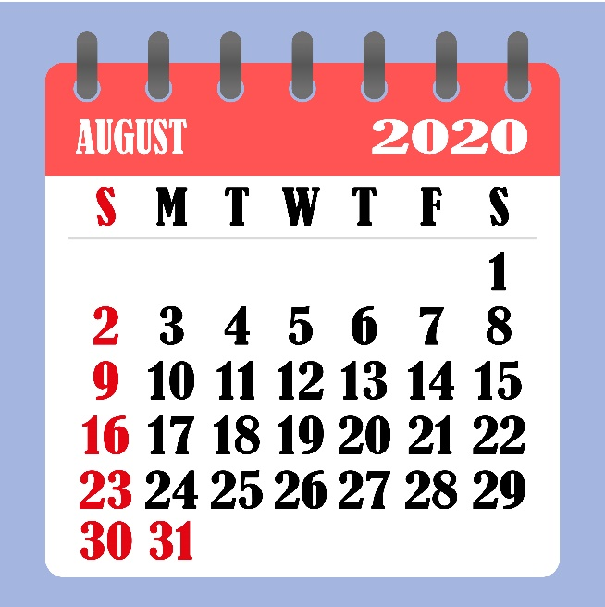
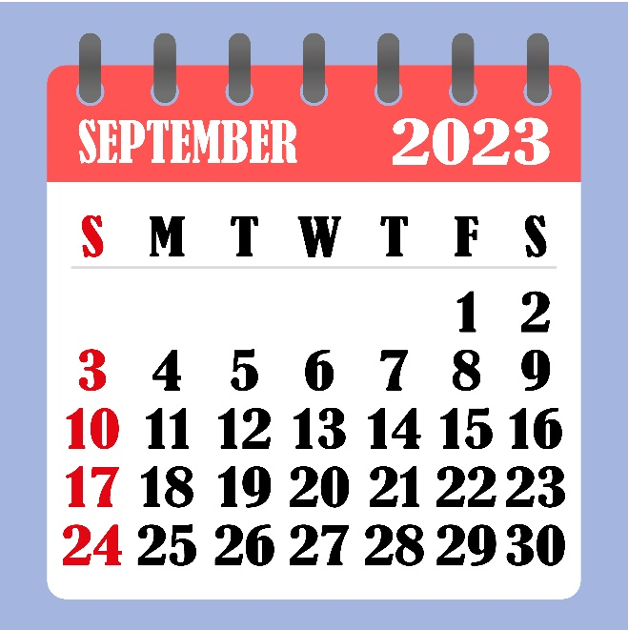
The Typical Doldrum Season
2021
2021

Slide 31
Questions?

Slide 33
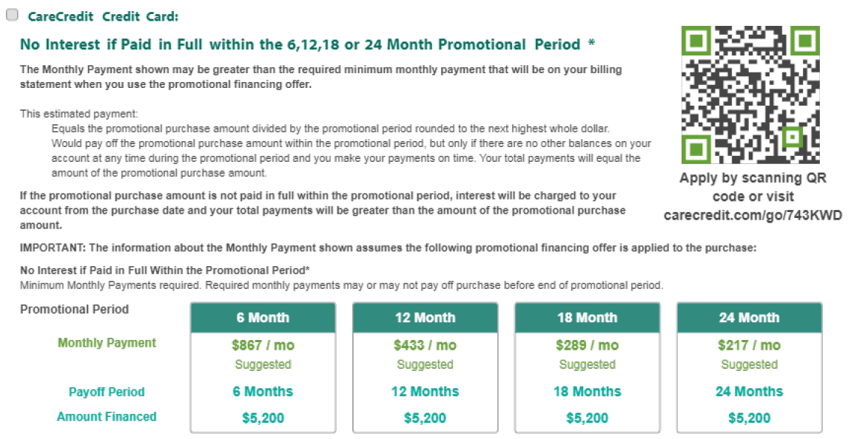

Slide 35
